Slide 1


PROJECT
2º Sprint Review
Turma B - Grupo 5
1170053 – Pedro Diniz
1211757 – Daniel Torres
1211759 – Diogo Veloso
1211765 – Gisela Araújo
1211779 – Márcio Carvalheiro
1211785 – Maurício Barros
1211788 – Patrick Rodrigues
1211797 – Tânia Mota
1211799 – Tiago Machado
1211801 – Valter Sousa

Slide 3
US14
As Director, I want to define the SM of a project
Author: Patrick rodrigues 1211788

Slide 6
Unit Tests JUnit

Slide 7
US15
As Director, I want to get a list of all projects
Author: Maurício barros 1211785

Slide 8
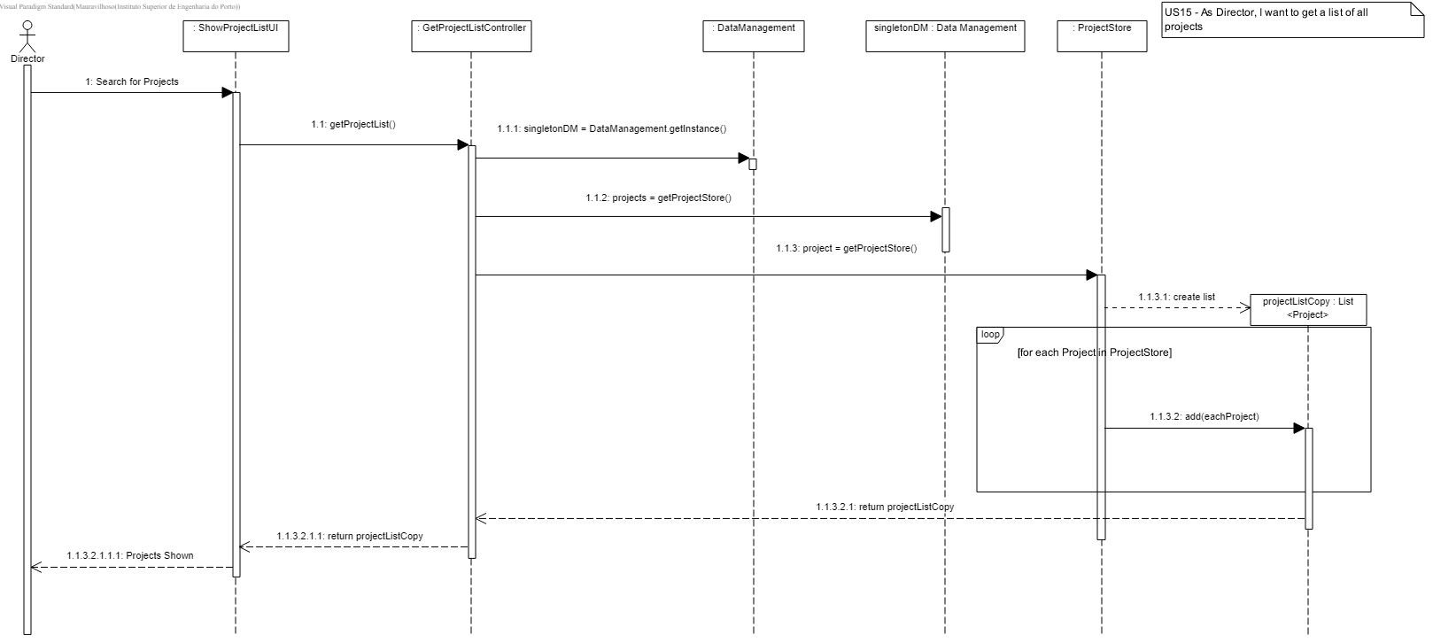
US 15 – Sequence Diagram

Slide 9
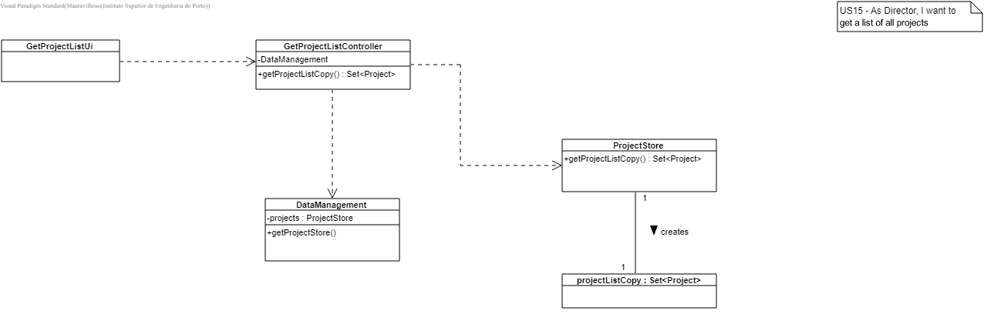
US15 – Class Diagram

Slide 10
Unit Tests JUnit
Test 1: Get the project list successfully
Test 2: Get an empty project list
Test 3: Get a project list with multiple projects

Slide 11
US16
As Director/PM/PO/SM, I want to view status of activities in a project
Author: Gisela araújo 1211765

Slide 12
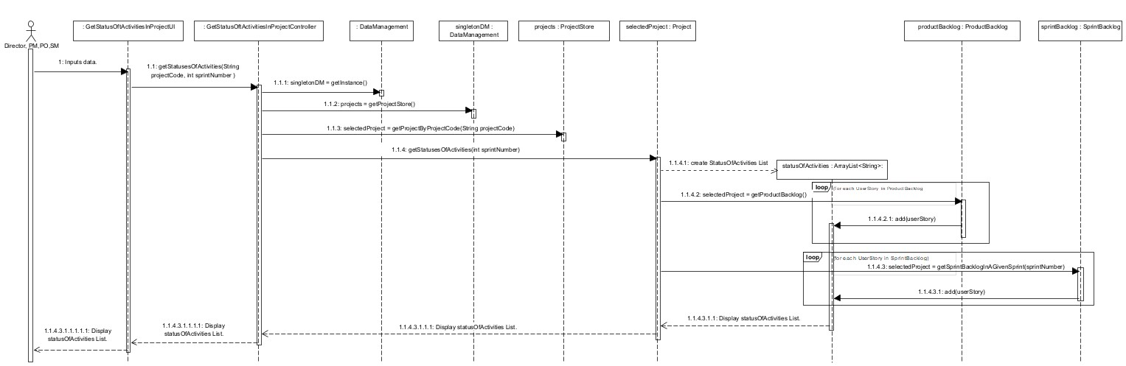
US016 - As Director/PM/PO/SM,I want to view status of activities in a project.
For the activities of a project we considered only the UserStories because at this moment we still don't have any user stories for creating tasks.

Slide 13
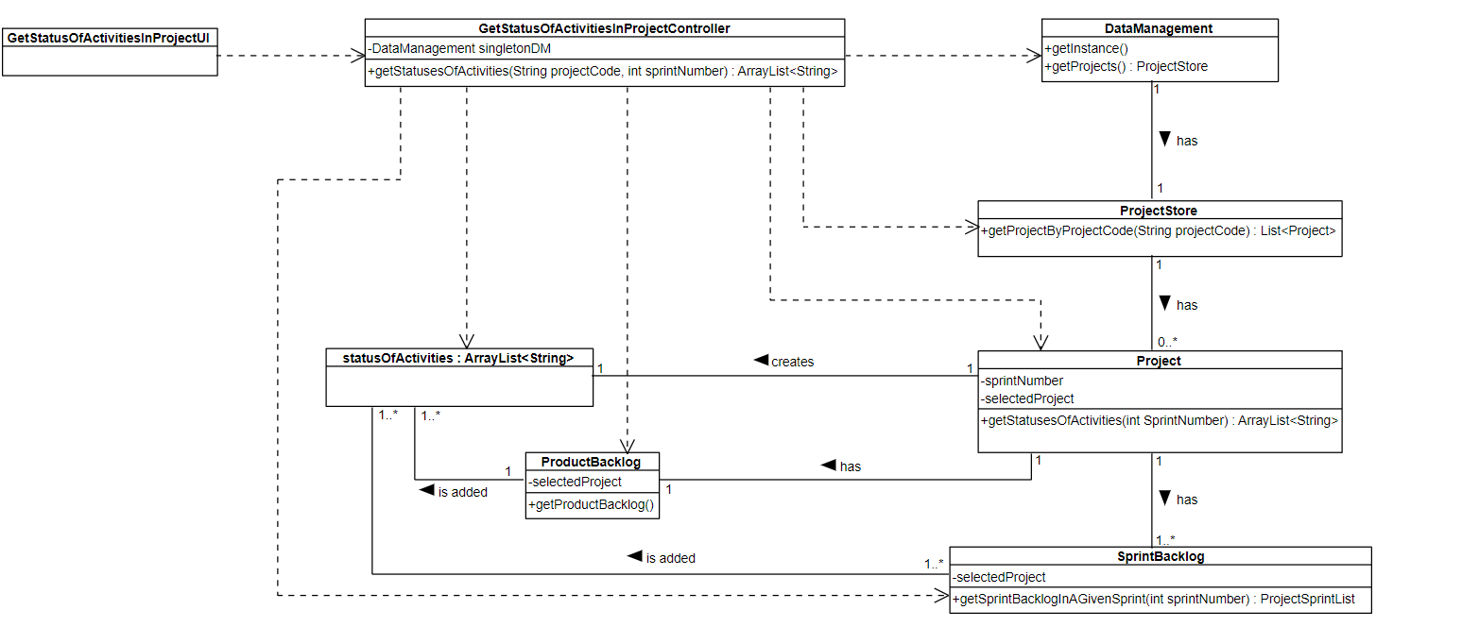
US016 - As Director/PM/PO/SM,
I want to view status of activities in a project.

Slide 14
Unit Tests JUnit
Test 1: Get Status of Activities in Sprint Backlog of a Project.
Test 2: Get Status of Activities in Product Backlog of a Project.
Test 3: Get Sprint Backlog in a Given Sprint (indirect test).
Test 4: Override toString() for User stories status and code description.
Test 5: Get status of a User Story.

Slide 15
US17
As Authenticated User, I want to get a list of all projects I'm currently allocated to
Author: pedro diniz 1170053

Slide 16
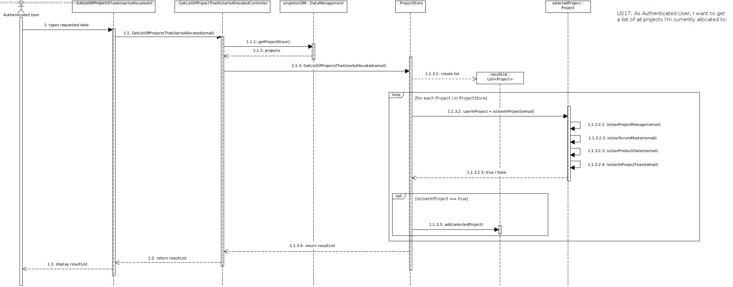
US 17 - Sequence Diagram

Slide 17
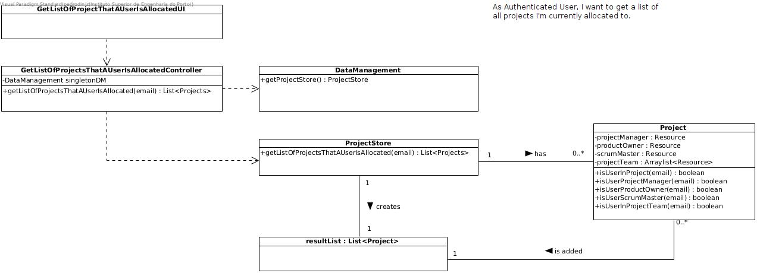
US 17 - Class Diagram

Slide 18
Unit Tests JUnit
Test 1: Get list of projects when user is allocated in a single project;
Test 2: Get list of projects when user is allocated in several projects with different roles;
Test 3: Get list of projects when user is not allocated in any project, returns an empty list;

Slide 19
US18
As PO/SM/Team Member, I want to consult the product backlog, i.e. to get the list of user stories sorted by priority
Author: diogo Veloso 1211759

Slide 20
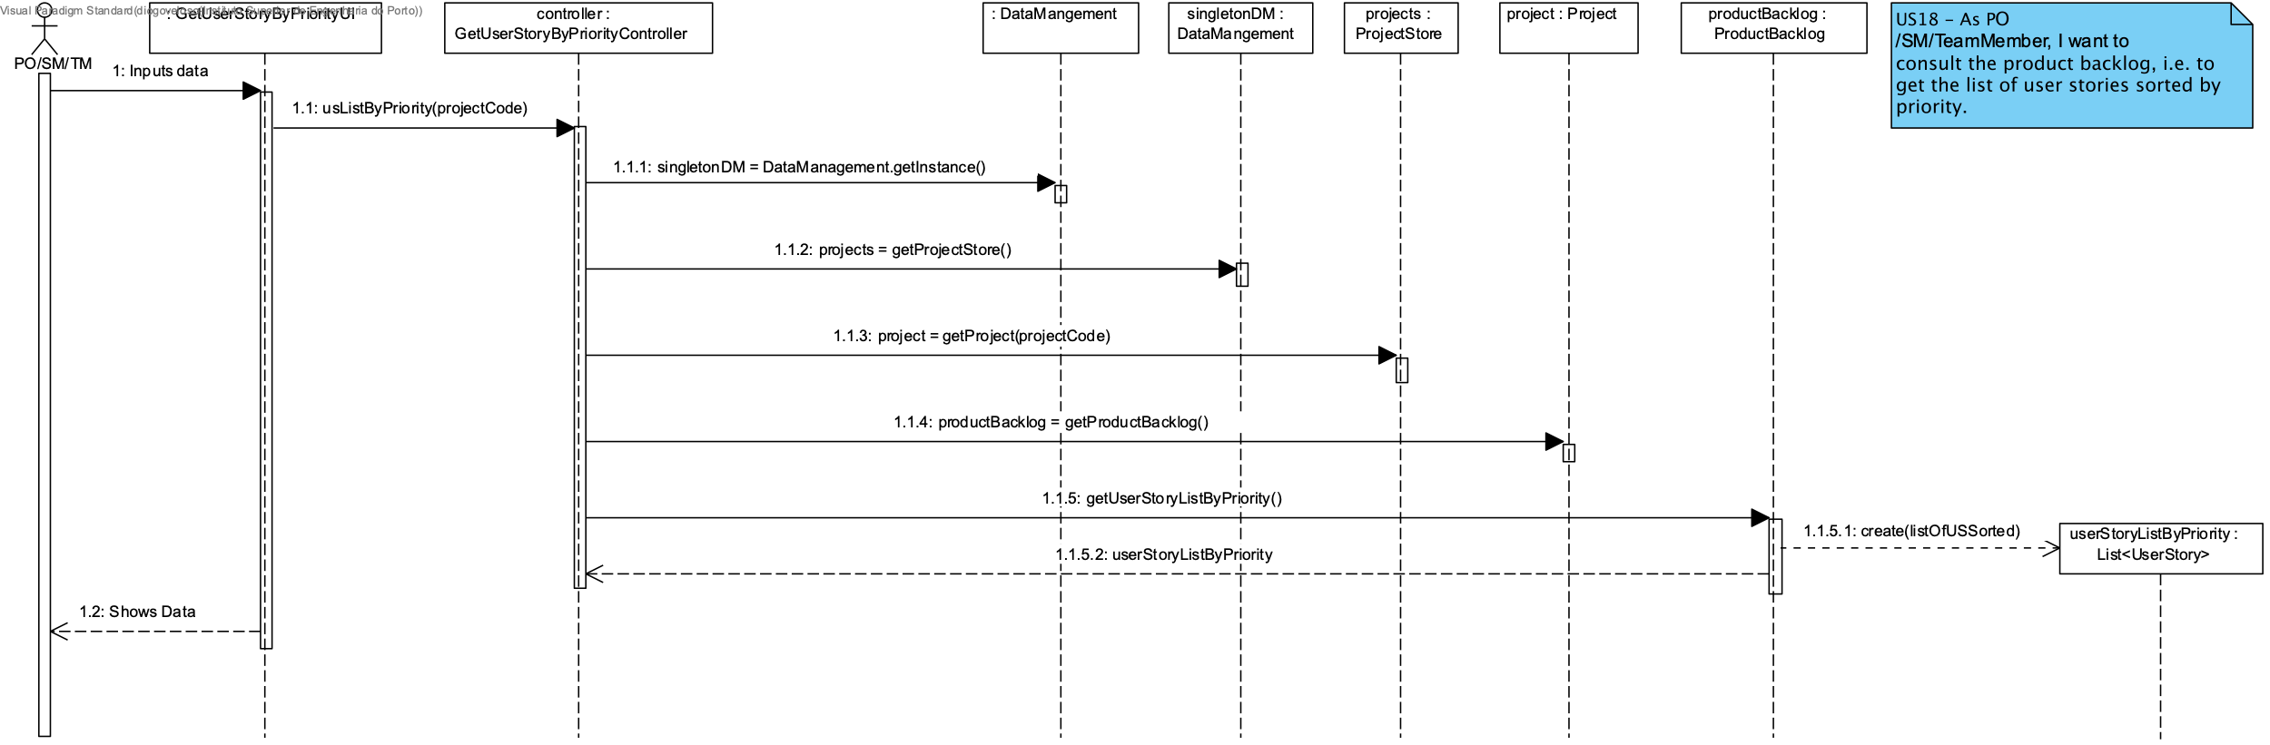
US 18 - Sequence Diagram

Slide 21
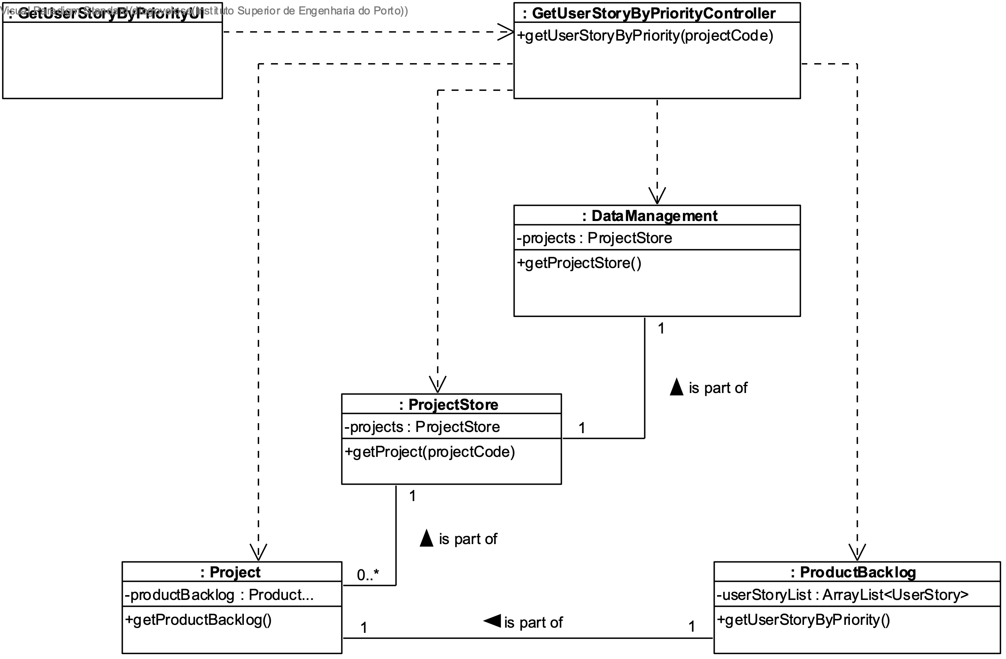
US 18 - Class Diagram

Slide 22
Unit Tests JUnit
ProductBacklogTest
Test 1: getUserStoryByPrioritySuccessfully()
Test 2: getUserStoryByPriorityAfterChangePriority()
GetUserStoryByPriorityControllerTest
Test 1: getUserStoryByPriorityWithNullParam()
Test 2: getUserStoryByPriorityWithoutProject()

Slide 23
US19
As Team Member, I want to estimate the effort of a user story
Author: Tânia Mota

Slide 24
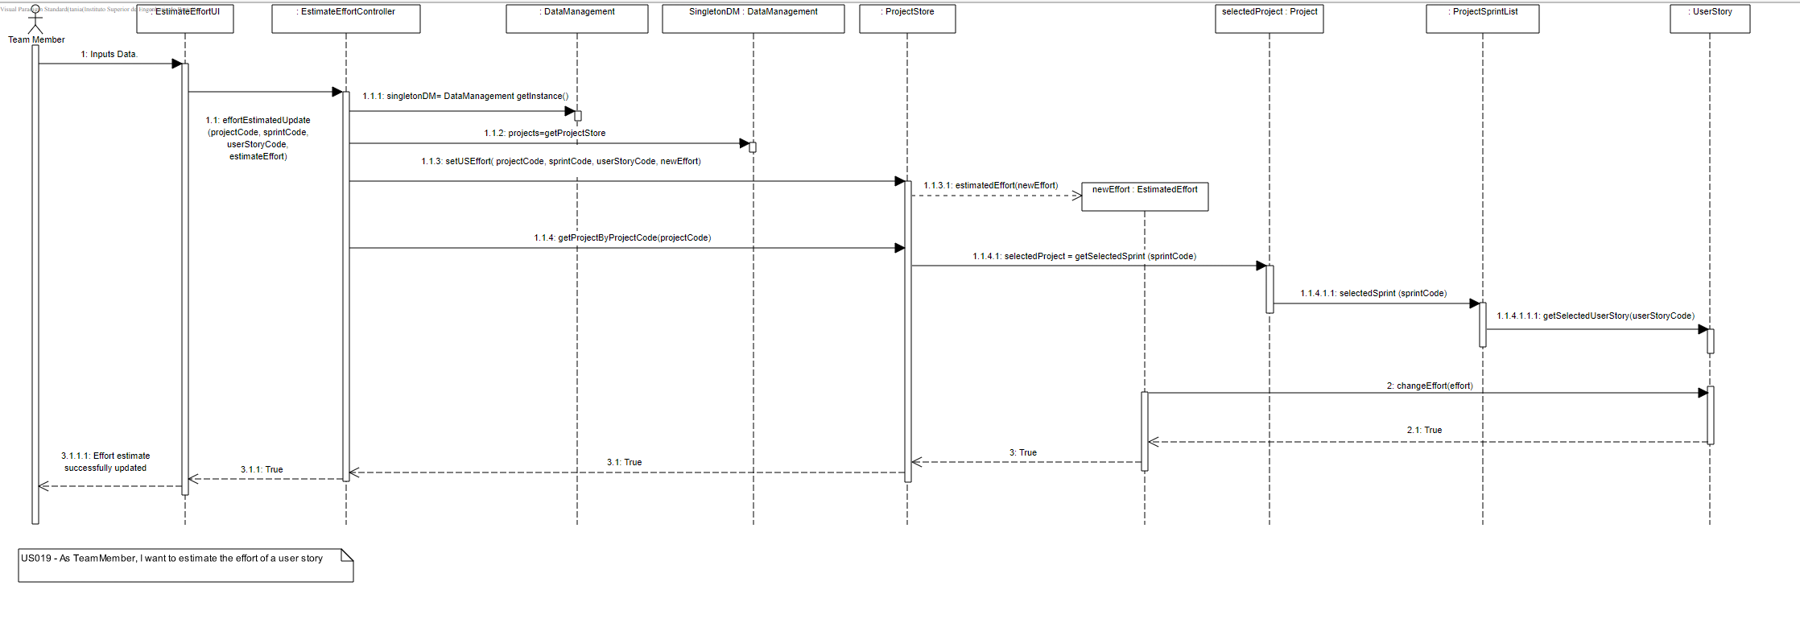

Slide 25
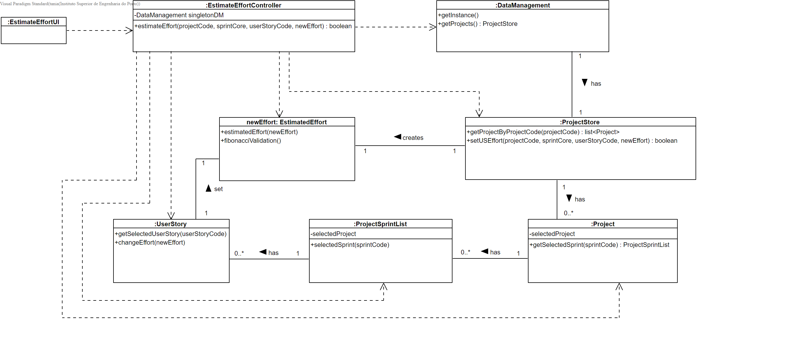

Slide 26
Unit Tests JUnit
Test 1 : Updating the effort estimated of a US succssefully
Test 2 : Updating the effort estimated of a US failure
Test 3 : Estimating the effort of a US successfully
Test 4 : Estimating the effort of a US fails if:
The project doesn’t exist;
The sprint doesn’t exist;
The US doesn’t exist;
Test 5 : Changing the effort of a US successfully
Test 6 : Validation of the Fibonacci sequence

Slide 27
US20
As Product Owner, I want to refine a broad user story of the ProductBacklog into more focused user stories
Author: márcio carvalheiro 1211779

Slide 28
US 20 - Sequence Diagram

Slide 29
US 20 – Class Diagram

Slide 30
Unit Tests JUnit
Test 1: Successful refinement of a User Story into more focused ones, returning true;
Test 2: Unsuccessful refinement due to null inputs, returning an exception;
Test 3: Unsuccessful refinement due to Project not being in store, returning false;
Test 4: Unsuccessful refinement due to User Story not being in Product Backlog, returning false;
Test 5: Unsuccessful refinement due to invalid new User Story descriptions, returning false;

Slide 31
US21
As Product Owner, I want to change the priority of a user story in the product backlog
Author: valter sousa 1211801

Slide 32
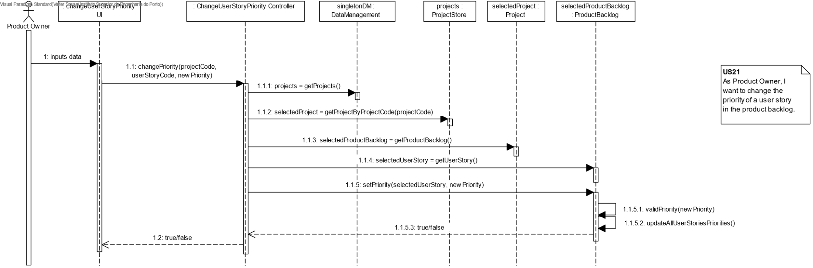

Slide 33
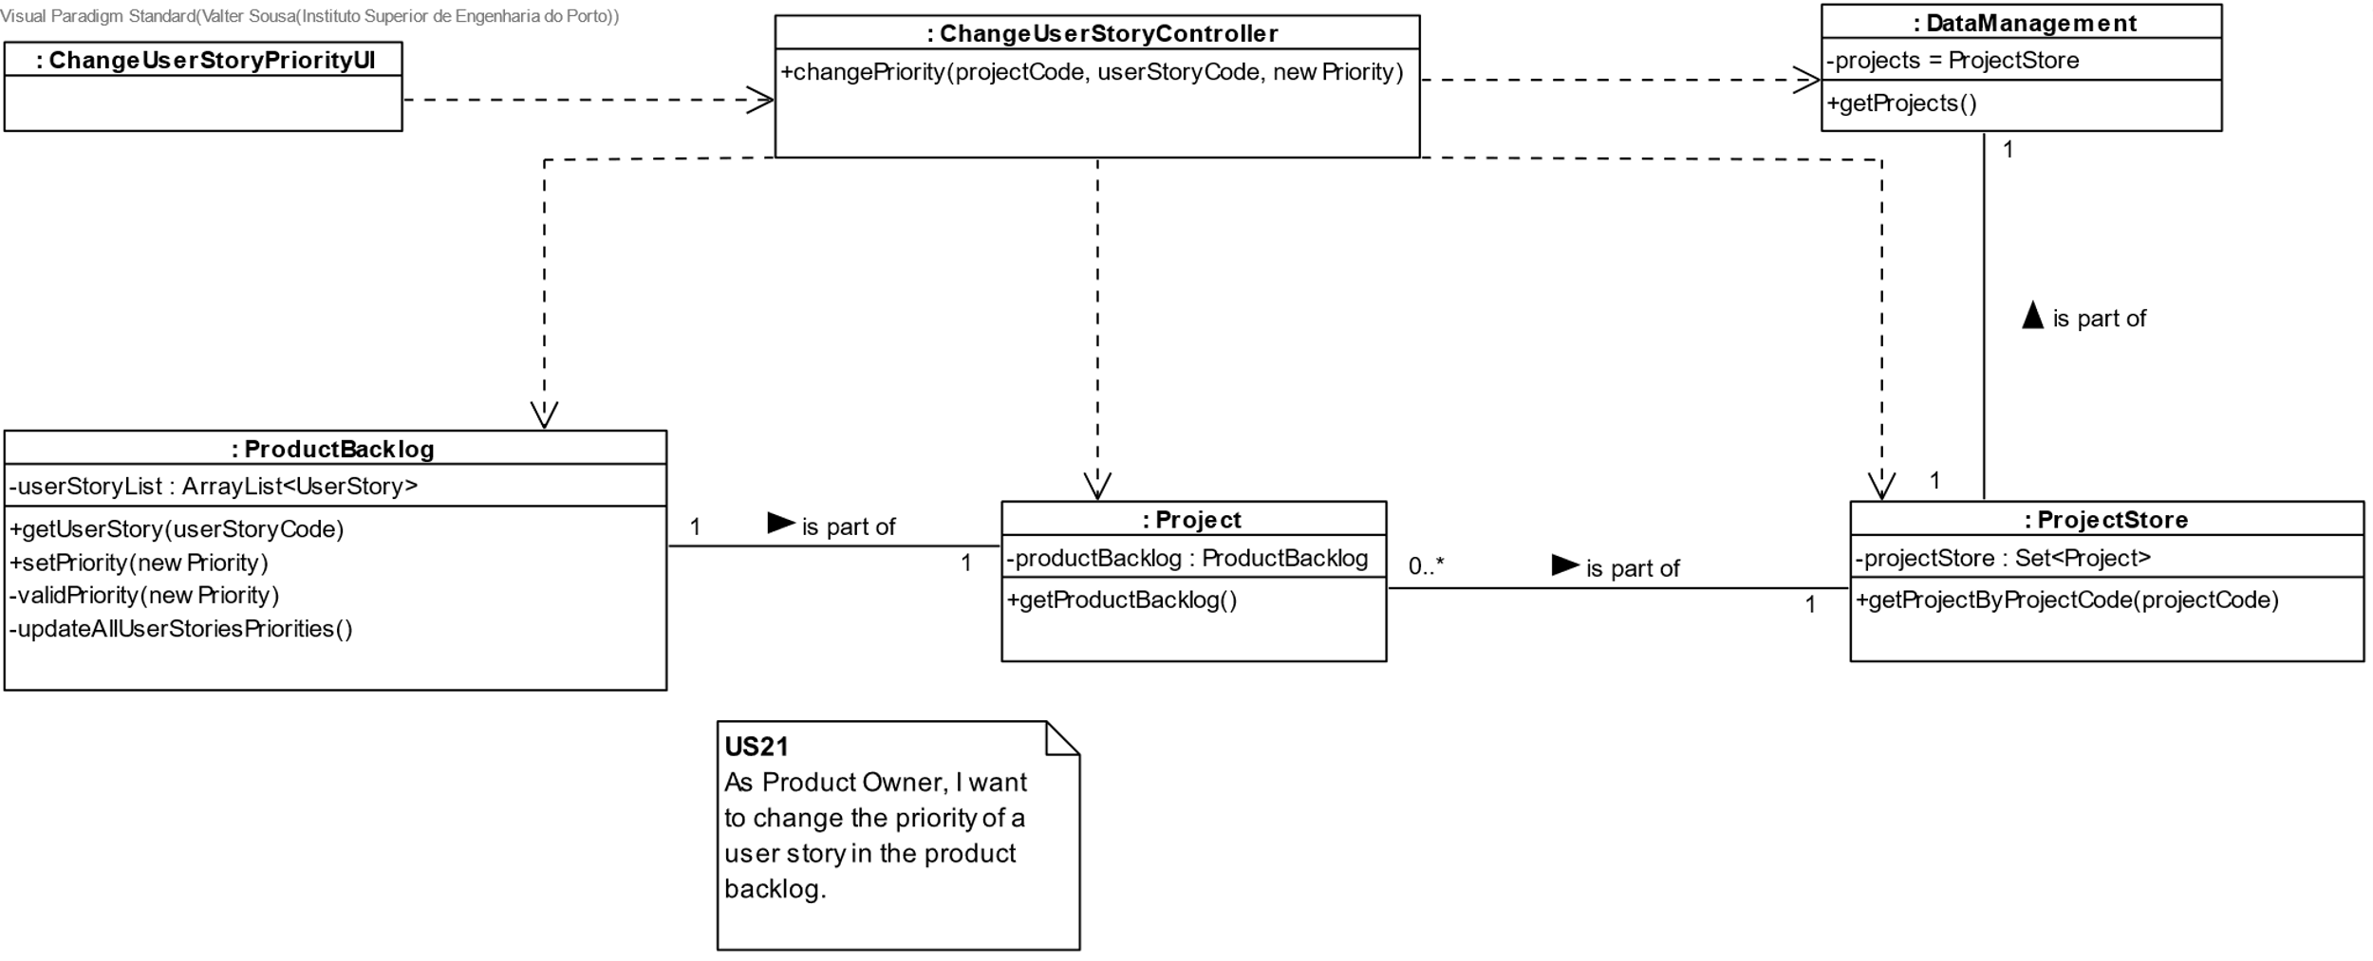

Slide 34
Unit Tests JUnit
Test 1: Validation of the new priority;
Test 2: Setting the priority of a User Story succssefully;
Test 3: Setting the priority of a User Story fails if:
Project does not exist;
User Story does not exist;
Null Parameters;
Test 4: When a priority is set, updates the priority of the other User Stories;

Slide 35
US22
As Project Manager, I want to create a sprint
Author: Daniel torres 1211757

Slide 36
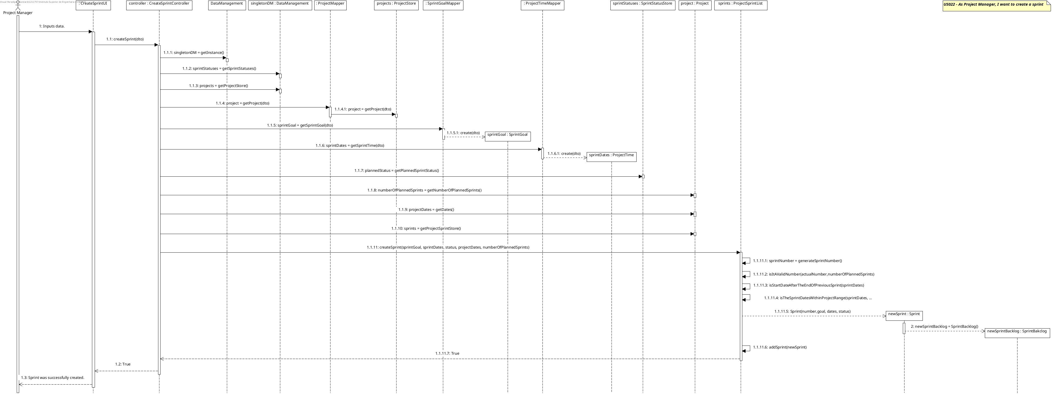

Slide 40
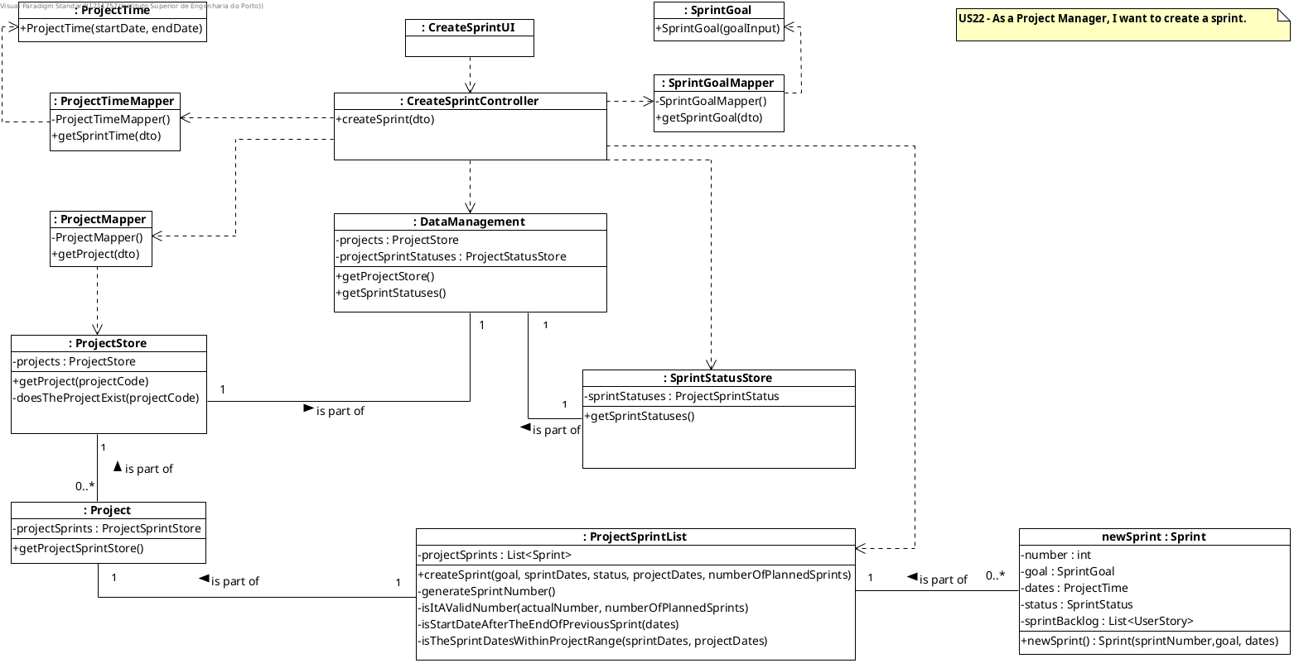

Slide 41
Unit Tests JUnit
Creation Of First Sprint Is Successful
Creation Of First Sprint Fails Because Of Invalid Data
Creation Of First Sprint Fails Because Of Invalid Description
Creation Of First Sprint Fails Because Sprint Dates Are Not In Project Time Interval
Creation Of First Sprint Fails Because Code Does Not Exists In Project Store
Creation Of Second Sprint Is Successful
Creation Of Second Sprint Fails Because Sprint Dates Are Not In Project Time Interval
Creation Of Second Sprint Fails Because Current Start Date Is Previous LastSprint End Date
Creation Of Third Sprint Fails Because Is Greater Than Expected Number Of Sprints

Slide 44
Unit Tests JUnit

Slide 45
US23
As Team Member, I want to add a user story in the product backlog to the sprint backlog
Author: tiago Machado 1211799

Slide 46
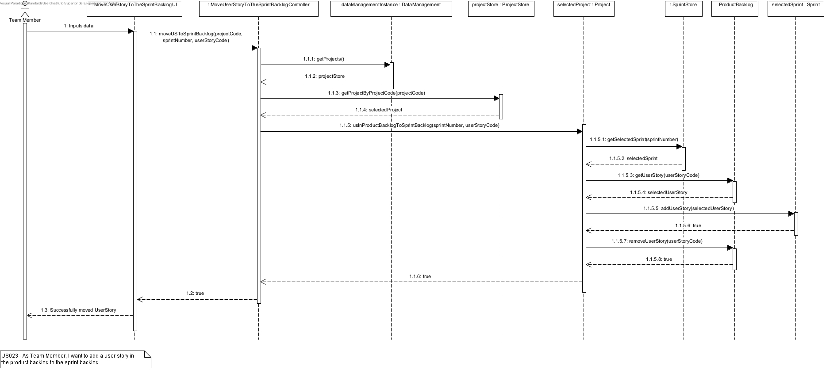

Slide 47
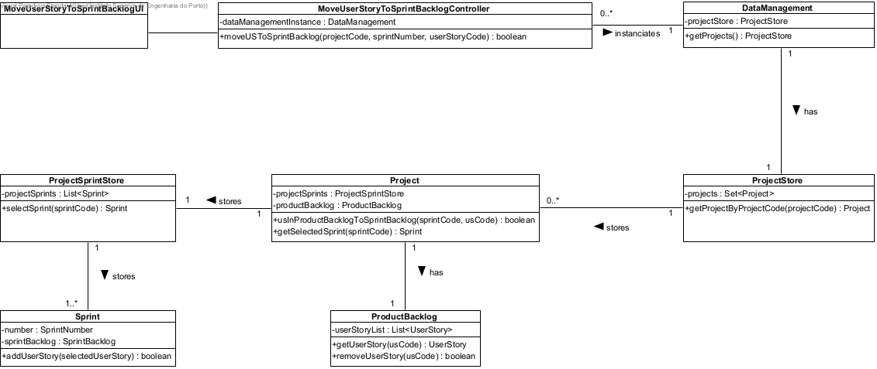

Slide 48
Unit Tests JUnit
Test a successful move of a user story in the product backlog to the sprint backlog.
Test a null project code.
Test a not null but still invalid project code.
Test an invalid sprint number.
Test a null user story code.
Test a not null but still invalid user story.

Slide 49
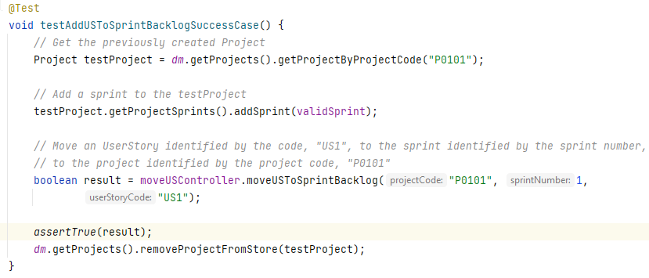
Success case test

Slide 50
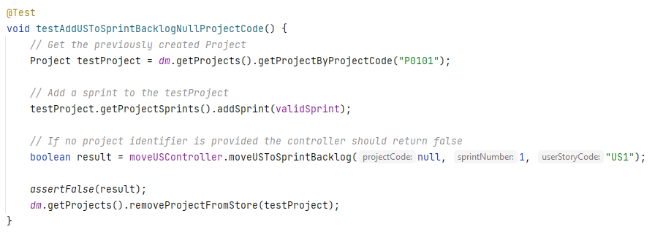
Null project code test

Slide 51
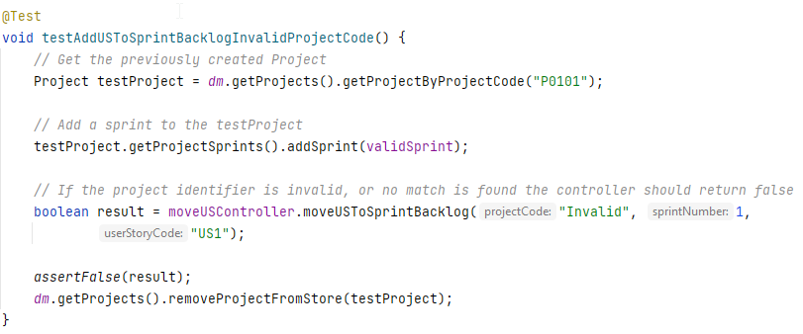
Invalid project code test

Slide 52
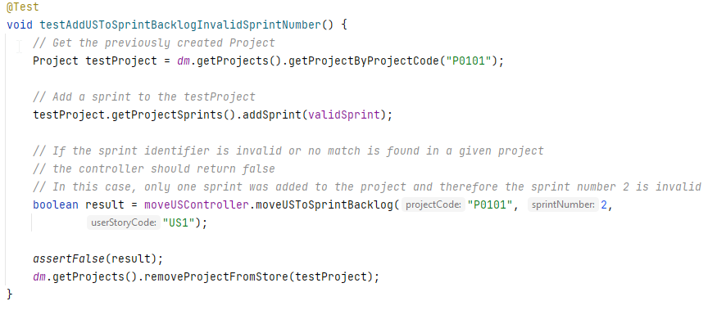
Invalid sprint number test

Slide 53
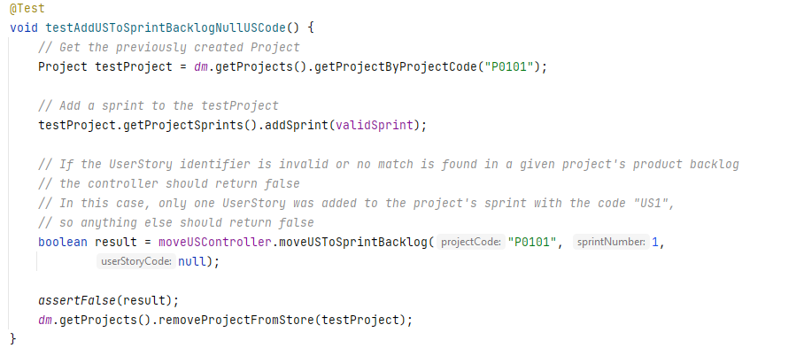
Null user story code test

Slide 54
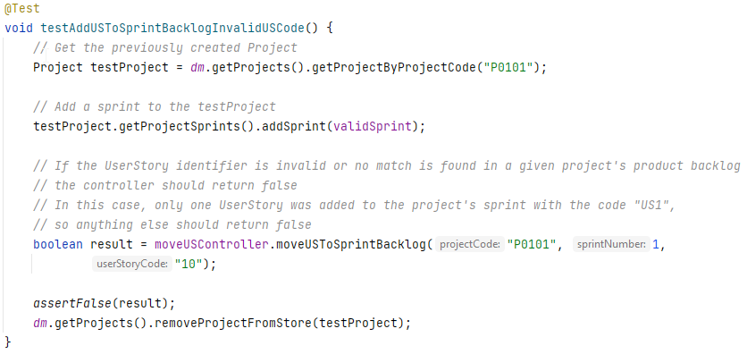
Invalid user story code test

